Slide 1
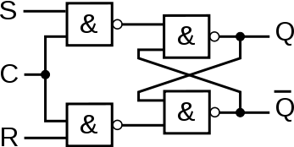
RST
S=1, R=0
R=1
S=0
0
1
S=1
R=0
S=0, R=1
S
R
0 | 1 | X | 0
1 | 1 | X | 0
Q
t_{N} |  |  | Q_{tN+1}
S | R | C
X | X | 0 | Q
0 | 0 | 1 | Q
0 | 1 | 1 | 0
1 | 0 | 1 | 1
1 | 1 | 1 | X
Q_{tN} | Q_{tN+1} | S | R
0 | 0 | 0 | X
0 | 1 | 1 | 0
1 | 0 | 0 | 1
1 | 1 | X | 0

Slide 2
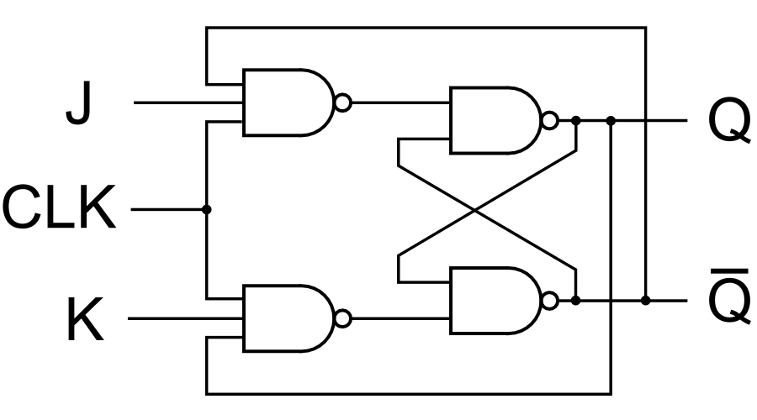
JK
J=1
J=0
0
1
K=0
K=1
J
K
0 | 1 | 1 | 0
1 | 1 | 0 | 0
Q
t_{N} |  | Q_{tN+1}
J | K
0 | 0 | Q
0 | 1 | 0
1 | 0 | 1
1 | 1 | /Q
Q_{tN} | Q_{tN+1} | J | K
0 | 0 | 0 | X
0 | 1 | 1 | X
1 | 0 | X | 1
1 | 1 | X | 0

Slide 3
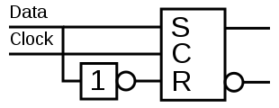
D
D=1
T=1
1
0
1
0
D=0
T=1
D=0
D=1
T=0
T=0
T
J=K=1
J=K=C
S=/R=/Q
D
T
0 | 1
0 | 1
0 | 1
1 | 0
Q
Q
Q_{tN} | Q_{tN+1} | D
0 | 0 | 0
0 | 1 | 1
1 | 0 | 0
1 | 1 | 1
Q_{tN} | Q_{tN+1} | T
0 | 0 | 0
0 | 1 | 1
1 | 0 | 1
1 | 1 | 0
t_{N} | Q_{tN+1}
D
0 | 0
1 | 1
t_{N} | Q_{tN+1}
T
0 | Q_{tN}
1 | /Q_{tN}

